Slide 1
Smart Design

Slide 2
Textbook
Unit 2 Beat Your Fear

Slide 3
Teaching Focus
to write up a short story based on
Freytag's Pyramid

Slide 4
Teaching Procedure

Slide 5
Offline text study: difficulties and structure
Unipus online course: language
Plot: Freytag's Pyramid
Retell an offline story concept explanation
Scaffolding write a story sequel
Ucampus: check understanding
Group work: online reading material for message
CLT story jigsaw: communication + creation
iWrite 2.0 assignment: enrich and polish the story

Slide 6
INPUT
Plot: Freytag's Pyramid
Retell an offline story concept explanation
Scaffolding write a story sequel
OUTPUT
Group work: online reading material for message
CLT story jigsaw: communication + creation
iWrite 2.0 assignment: enrich and polish the story

Slide 7
References
Gustav Freytag. Freytag's Technique of the Drama: An Exposition of Dramatic Composition and Art. Chicago: Scott, Foresman and Company, 1894.
R. Keith Sawyer. The Cambridge Handbook of the Learning Sciences. New York: Cambridge University Press, 2006.
Klaus Brandl. Communicative Language Teaching in Action: Putting Principles to Work. Upper Saddle River, NJ: Phil Miller, 2007.

Slide 8
Classroom Teaching Demo

Slide 11
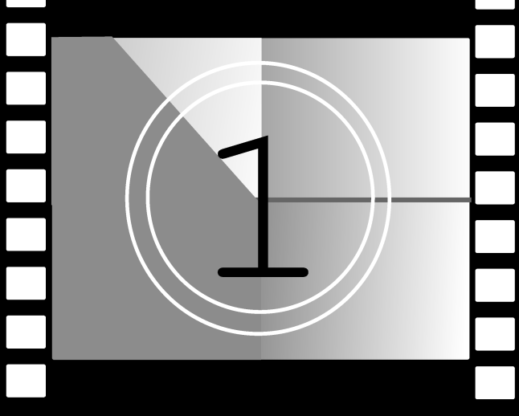

Slide 13
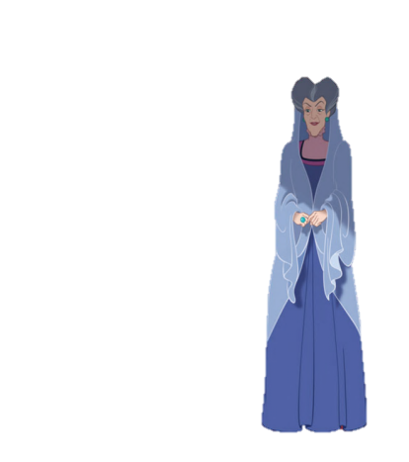
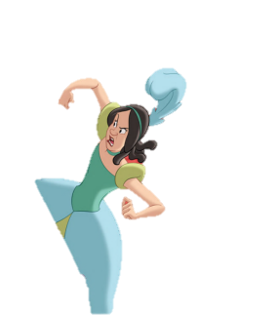
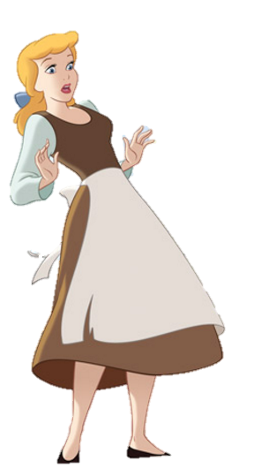
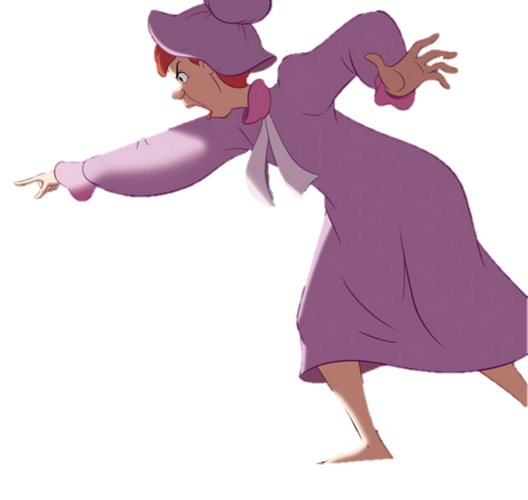
Retell the Story of Cinderella

Slide 14
inciting incident
character
setting
Setting: when & where
Character: person or other being
inciting incident: trigger the plot

Slide 15
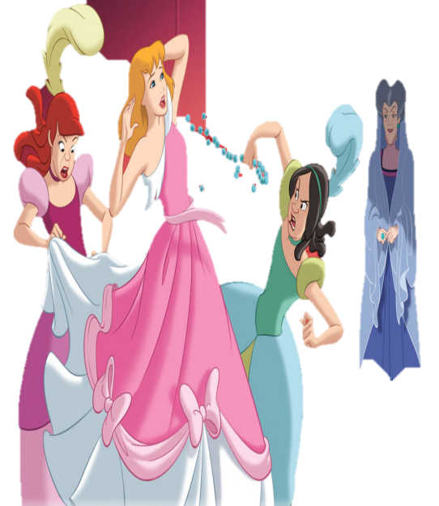
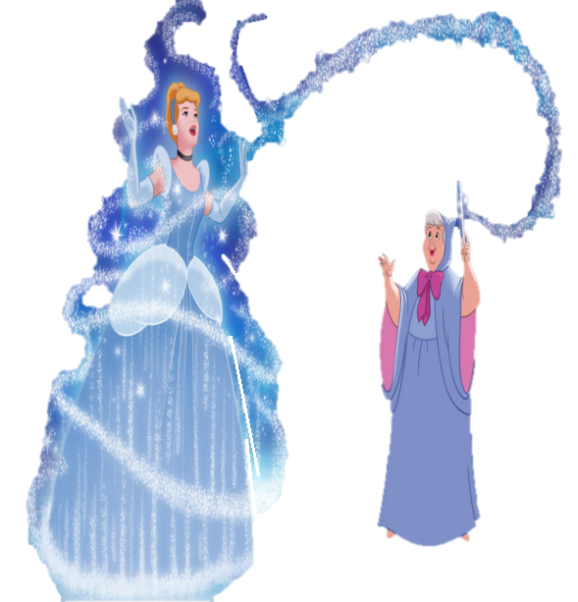
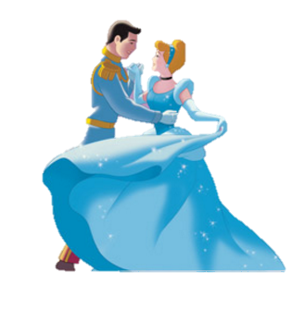
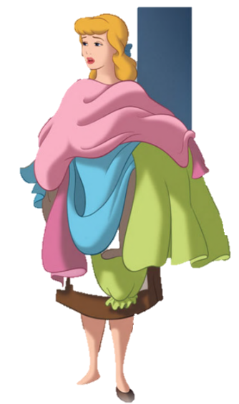
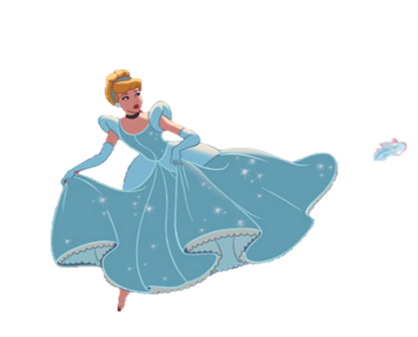
Retell the Story of Cinderella

Slide 16
rising action:
build-up
rising action
inciting incident
character
setting
Setting: when & where
Character: person or other being
inciting incident: trigger the plot

Slide 17
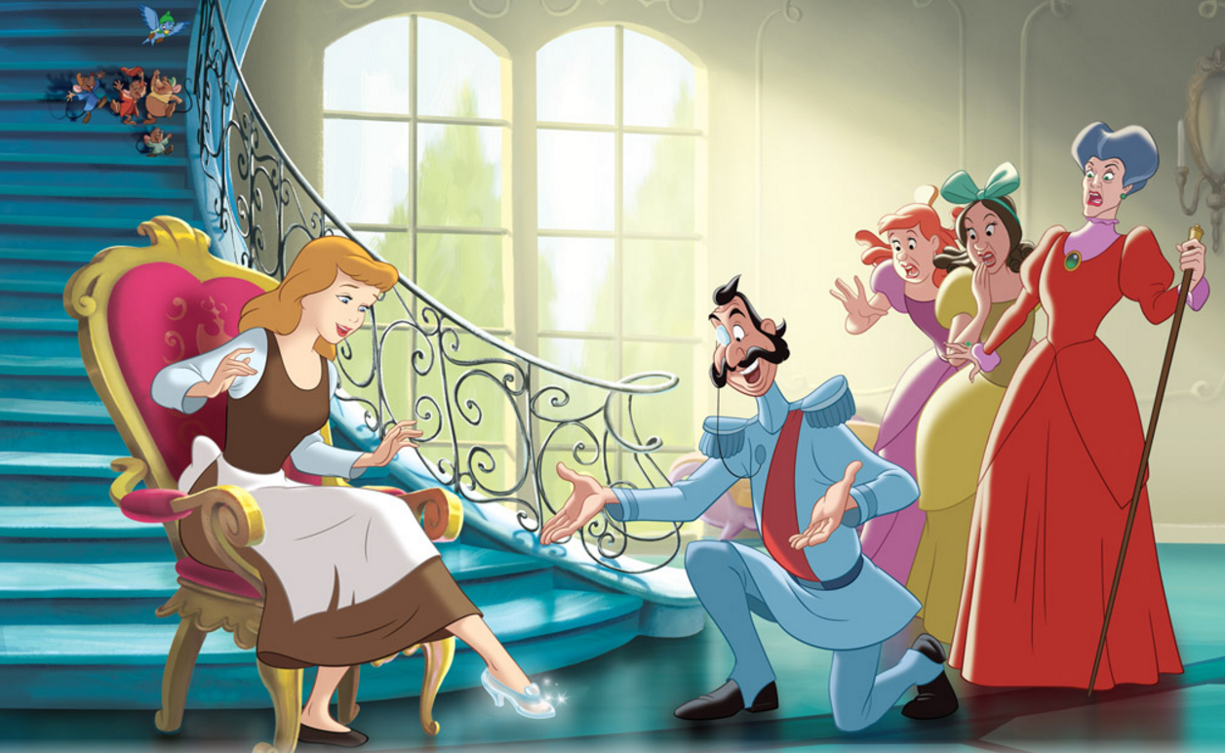
Retell the Story of Cinderella

Slide 18
climax: turning point
rising action:
build-up
climax
rising action
inciting incident
character
setting
Setting: when & where
Character: person or other being
inciting incident: trigger the plot

Slide 19
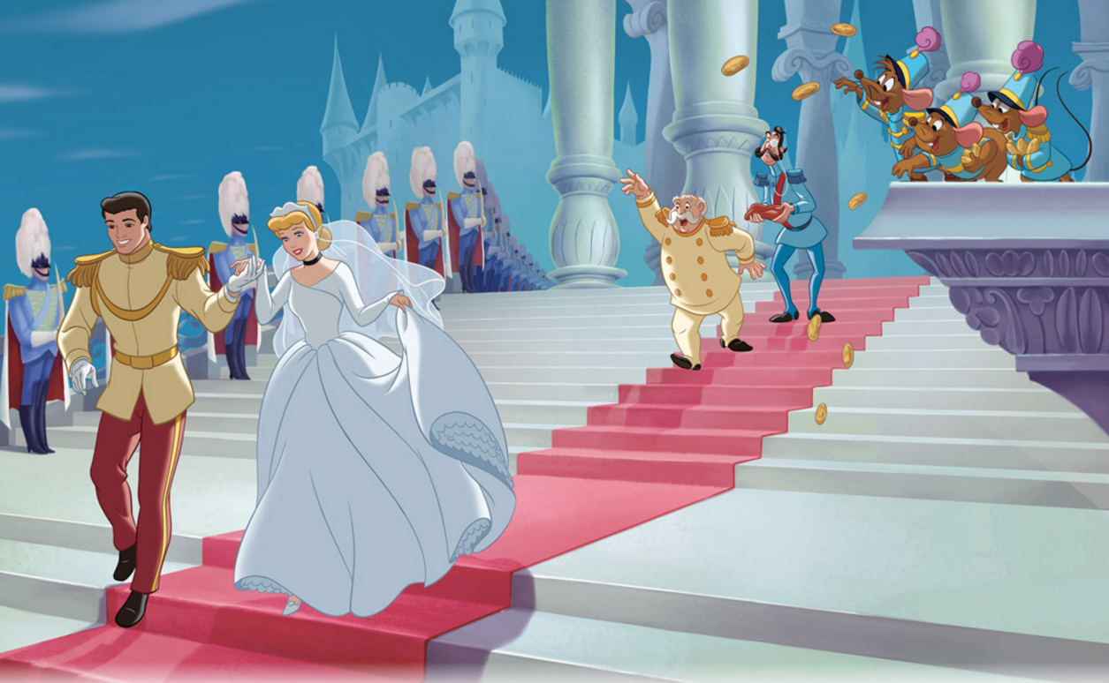
Retell the Story of Cinderella

Slide 20
climax: turning point
rising action:
build-up
climax
falling action:
climax effect
rising action
falling action
inciting incident
character
setting
Setting: when & where
Character: person or other being
inciting incident: trigger the plot

Slide 21
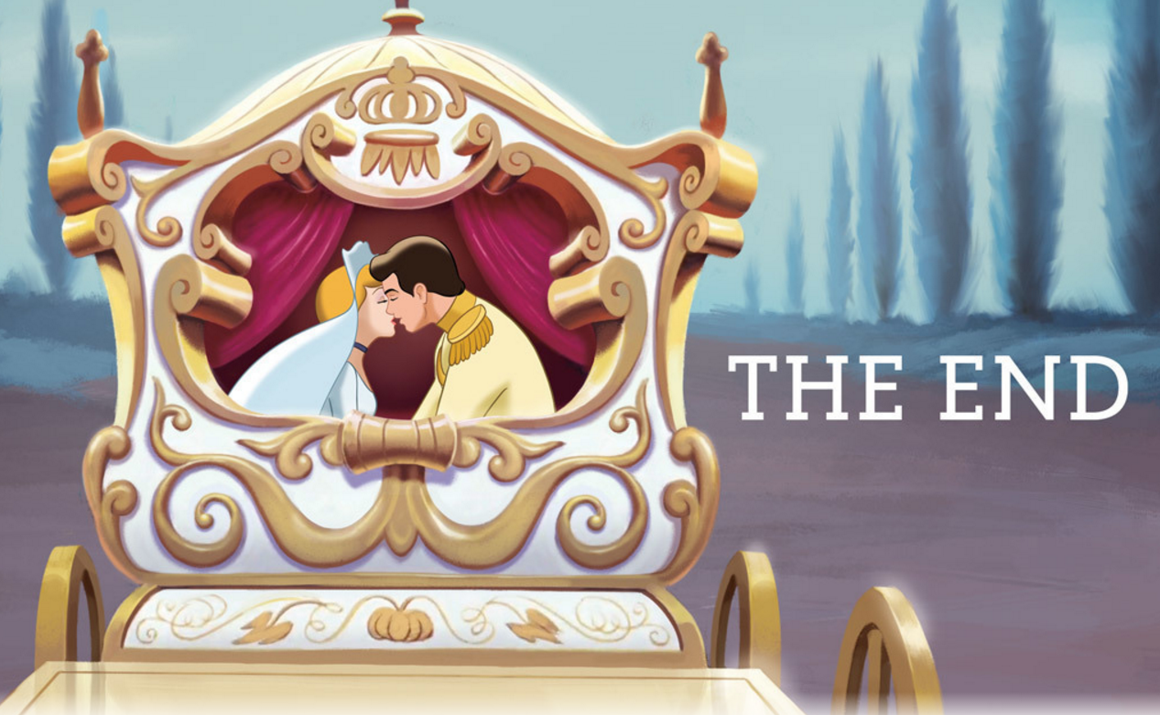
Retell the Story of Cinderella

Slide 22
A Story's Plot (Freytag's Pyramid)
climax: turning point
rising action:
build-up
climax
falling action:
climax effect
rising action
falling action
inciting incident
character
setting
denouement
denouement: ending
Setting: when & where
Character: person or other being
inciting incident: trigger the plot

Slide 23
Write Cinderella's Sequel with Freytag's Pyramid
Since she got married, Cinderella had been leading a happy life in her far away country. One day, word came that her fairy godmother was dying soon.
Setting, Character, Inciting Incident
Rising Action
Climax
Falling Action
Fed up with this relationship, Cinderella decided to leave in search for her Mr. Right who could offer her a reassurance of true love.
Denouement

Slide 24
Thank you!

